Slide 1
Rules for the Final Exam
Closed book, through Zoom and Google classroom
No electronics, no magnifiers, multiple versions
Time: two hours and the same time as stated on the syllabus
Webcam through Zoom:
Request a webcam to show your face from start to end
Go to restroom before the exam starts
No conversation and connection with any other people till exam ends
Note sheet allowed:
Letter size, single sheet of paper, two sided
Write your name and ID number on the sheet
Do not copy homework problems or solutions on the sheet
Hand in at Google Classroom
1. exam sheet (original exam printed or your answer sheet)
2. a picture of your MSU ID
3. Note sheet (mark “no sheet” on the exam or answer sheet if you do not use a note sheet)

Slide 2
The Last Week of the Semester
Today: Programs and computer models
Wednesday: review

Slide 3
Programs and Computer Models
Computer languages
Assembly languages
Higher level languages: C, C++, Java, Python …
Compilers: rules to translate to binary codes
What do we mean by general-purpose computers?
Is a C language program general purpose (GP)?
Is the entire collection of all C programs GP
Did we address GP so far?

Slide 4
Examples of Tasks
Vision Guided Navigation, not just laser
Audition, not just speech processing
Natural language understanding, not just language processing …
Pattern recognition
Games (clean problems, not AI problems?)

Slide 5
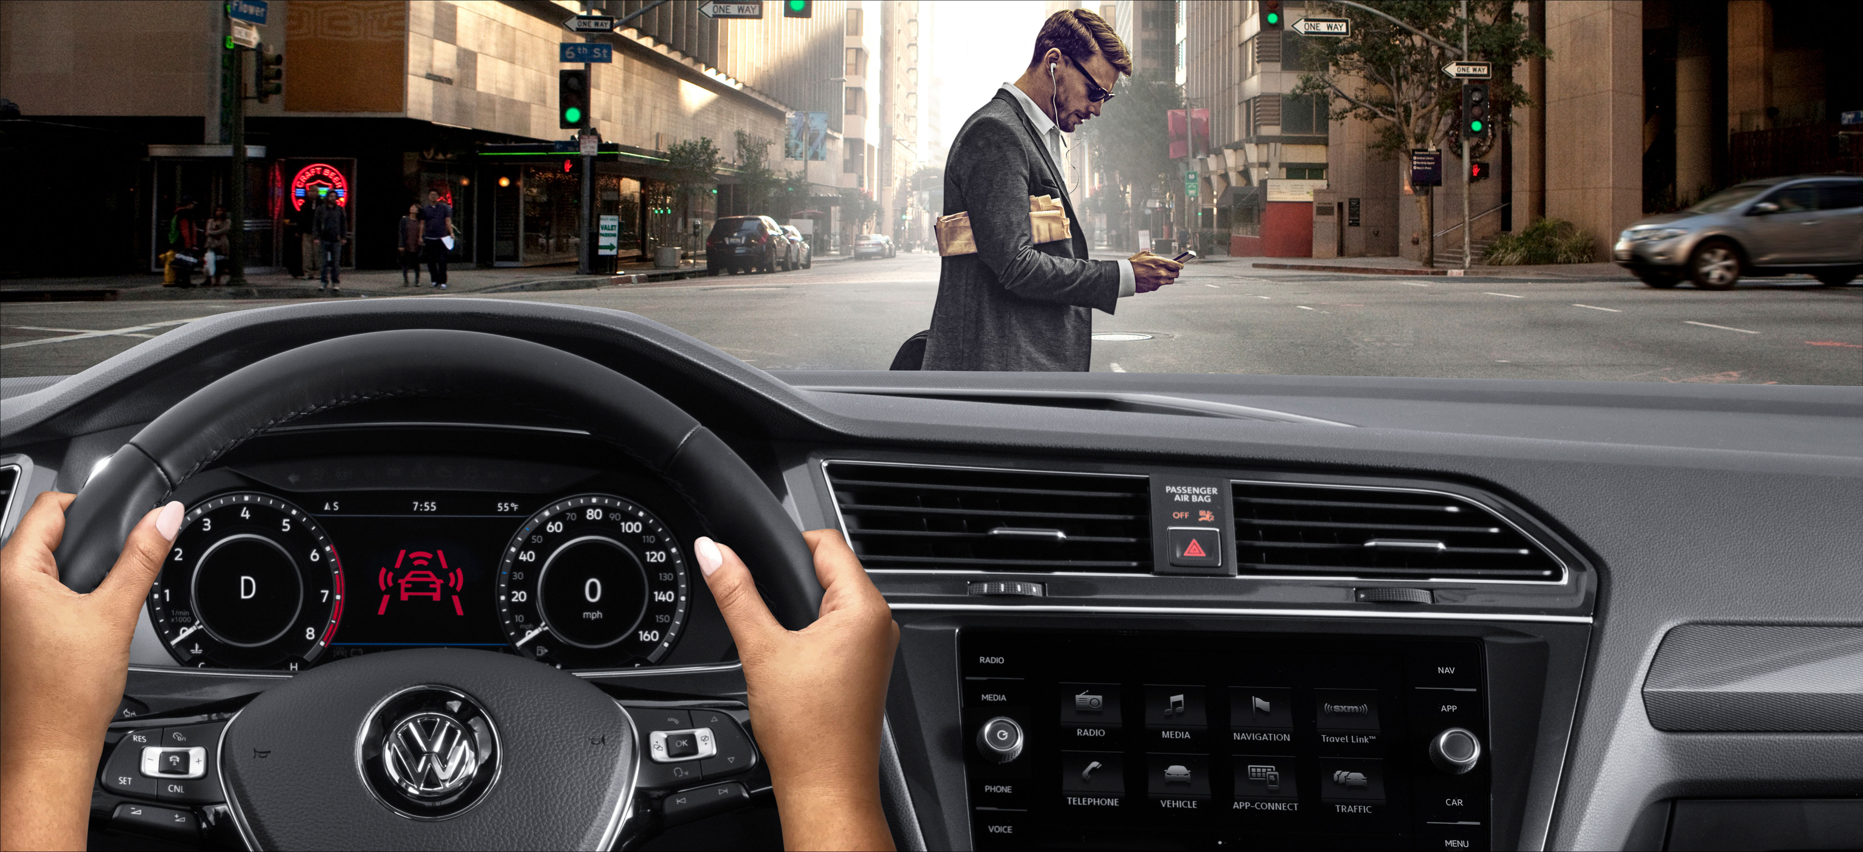
Task Specific: Vision Guided Navigation
Pedestrians, cars, traffic signs, shadows …

Slide 6
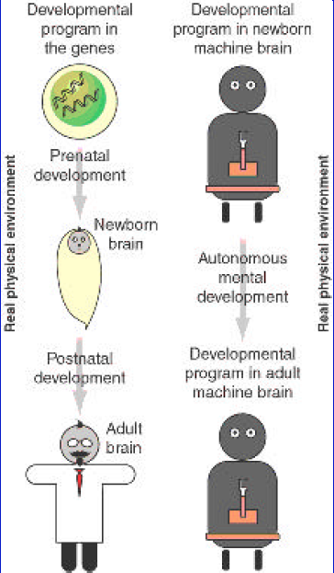
Must Auto-Develop
Workshop on Development and Learning, 2000, NSF & DARPA funded
Weng et al. Autonomous Mental Develop by Robots and Animals, Science 2001 Task-nonspecificity!
“Genome-like” Developmental Network DN, only about 2 pages long
IEEE ICDL Conferences
IEEE AMD Technical Committee
2009 IEEE Transactions on AMD
Since 2008, WWN-1 through WWN-9
APFGP: Autonomous Programming for General Purposes

Slide 7
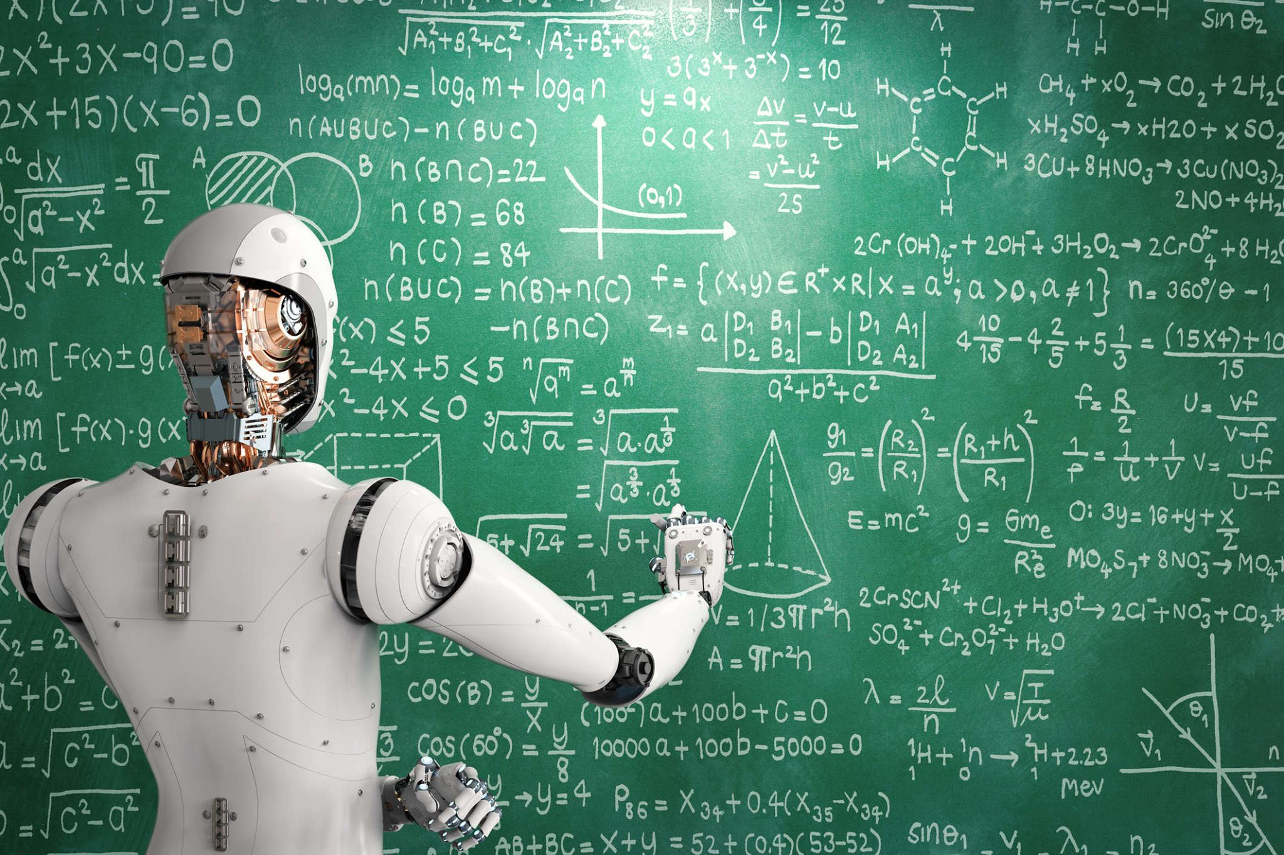
APFGP
APFGP: Autonomous Programming for Genera Purposes
Inside skull: Fully autonomous
Skull closed throughout a life
Outside skull: nature including humans as teachers

Slide 8
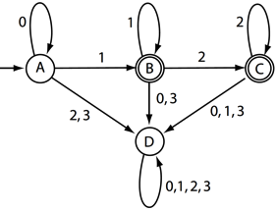
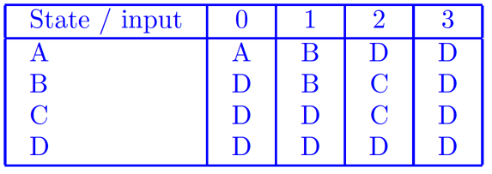
Finite Automaton (FA)
All symbolic AI: No skull-internal representations!
Many thought some are internal but this is wrong!

Slide 9
Turing Machine (TM): Special Purpose
The tape has input data
A well-accepted model for digital computers
Simple but rigorous
A unlimited tape, a read-write head, a look-up table

Slide 10
Universal Turing Machine (GP!)
The tape has input data
The tape has input program and data

Slide 11
Control of a TM
Program example: (q1, sigma1) -> (q2, sigma2, R) (q1, sigma1) -> (q3, sigma2, L) …
Does that look-up table look like a C program?

Slide 12
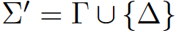
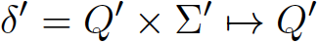
New theory in Computer Science: Convert a Turing Machine into an FA
FA!
FA Program example: (q1, sigma1) -> q2 (q2, sigma1) -> q3
…
Weng IJIS 2015, IJCNN 2015

Slide 13
Traditional FA: Symbolic Look-Up Table
All symbolic AI: No skull-internal representations!
Many thought some are internal but this is wrong!

Slide 14
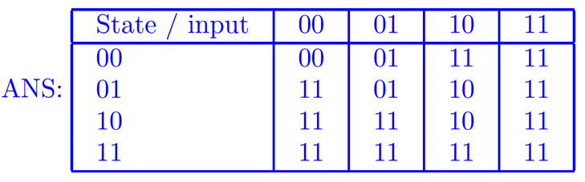
Brain-Like Emergent FA: Patterns Only
Inputs: pixels patterns
State: Patterns in
muscles!

Slide 15
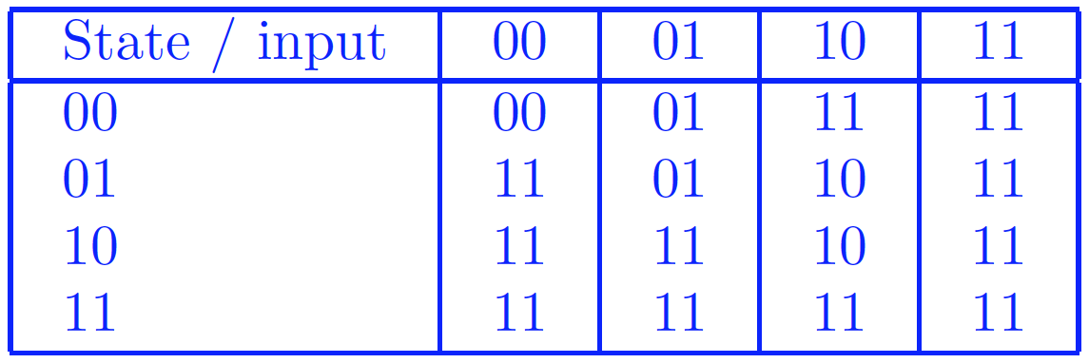
Our Developmental Network (DN): Wire Incrementally
Y gives skull-internal representations!
Y
Y
Y
Y

Slide 16
GENISAMA for APFGP (Auto-Programming for General Purposes)
G: Grounded: in the physical world
E: Emergent: in all its representations (patterns)
N: Natural: in use natural images and motors
I: Incremental: learning. Not like AlphaGo
S: Skull-closed: cannot supervise hidden layers
A: Attentive: Parallel detection & recognition
M: Motivat’n: pain, pleasure, uncertainty, novelty
Abstractive: where, what, scales, goals, intents, … thoughts

Slide 17
Quiz 27
What is wrong below?
Compilers do not understand the programs they compile.
Machines cannot do debug for general purposes.
It is impossible for a machine to conduct Auto-Programming for General Purposes.
The existing theorem-proving methods are mainly possible for the first-order logic.

